Slide 1
Microbial genetics
EMD 531
Lecture 2
Chantal Vogels, PhD

Slide 2
Learning objectives
Students will be able to
Explain the basic concepts of the genetic code and variation
Identify drivers of population dynamics
Compare genetics/genomics of viruses, bacteria, and parasites
Discuss how pathogen evolution can be translated in epidemiology

Slide 3
Question 1: What is your undergraduate major?
PollEv.com/cvogels425

Slide 4
Genetic code and variation

Slide 5

Phenotype = Genotype * Environment

Slide 6
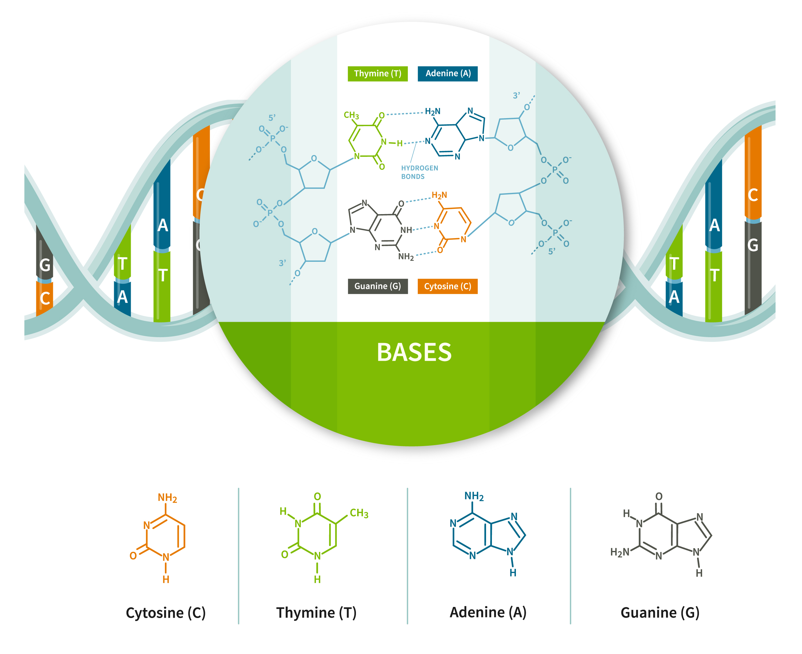
Microbial genomes consist of DNA or RNA
3 nucleotides
=
1 codon
(unit of genetic code)
=
1 amino acid
(building block for proteins)
Pyrimidines
Purines

Slide 7
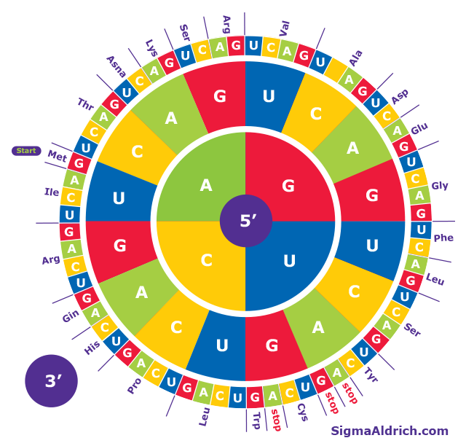
The universal genetic code

Slide 8
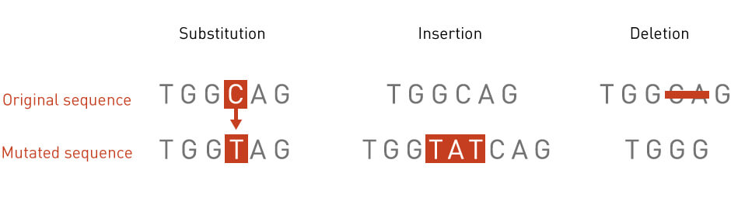
Genetic variation
Mutations
Transition = purine (A,G) ⟷ purine
pyrimidine (C,T) ⟷ pyrimidine
Transversion = purine ⟷ pyrimidine
Pyrimidines
Purines

Slide 9
Genetic variation
Mutations
Synonymous mutation = no change in amino acid
Non-synonymous mutation = change in amino acid

Slide 10
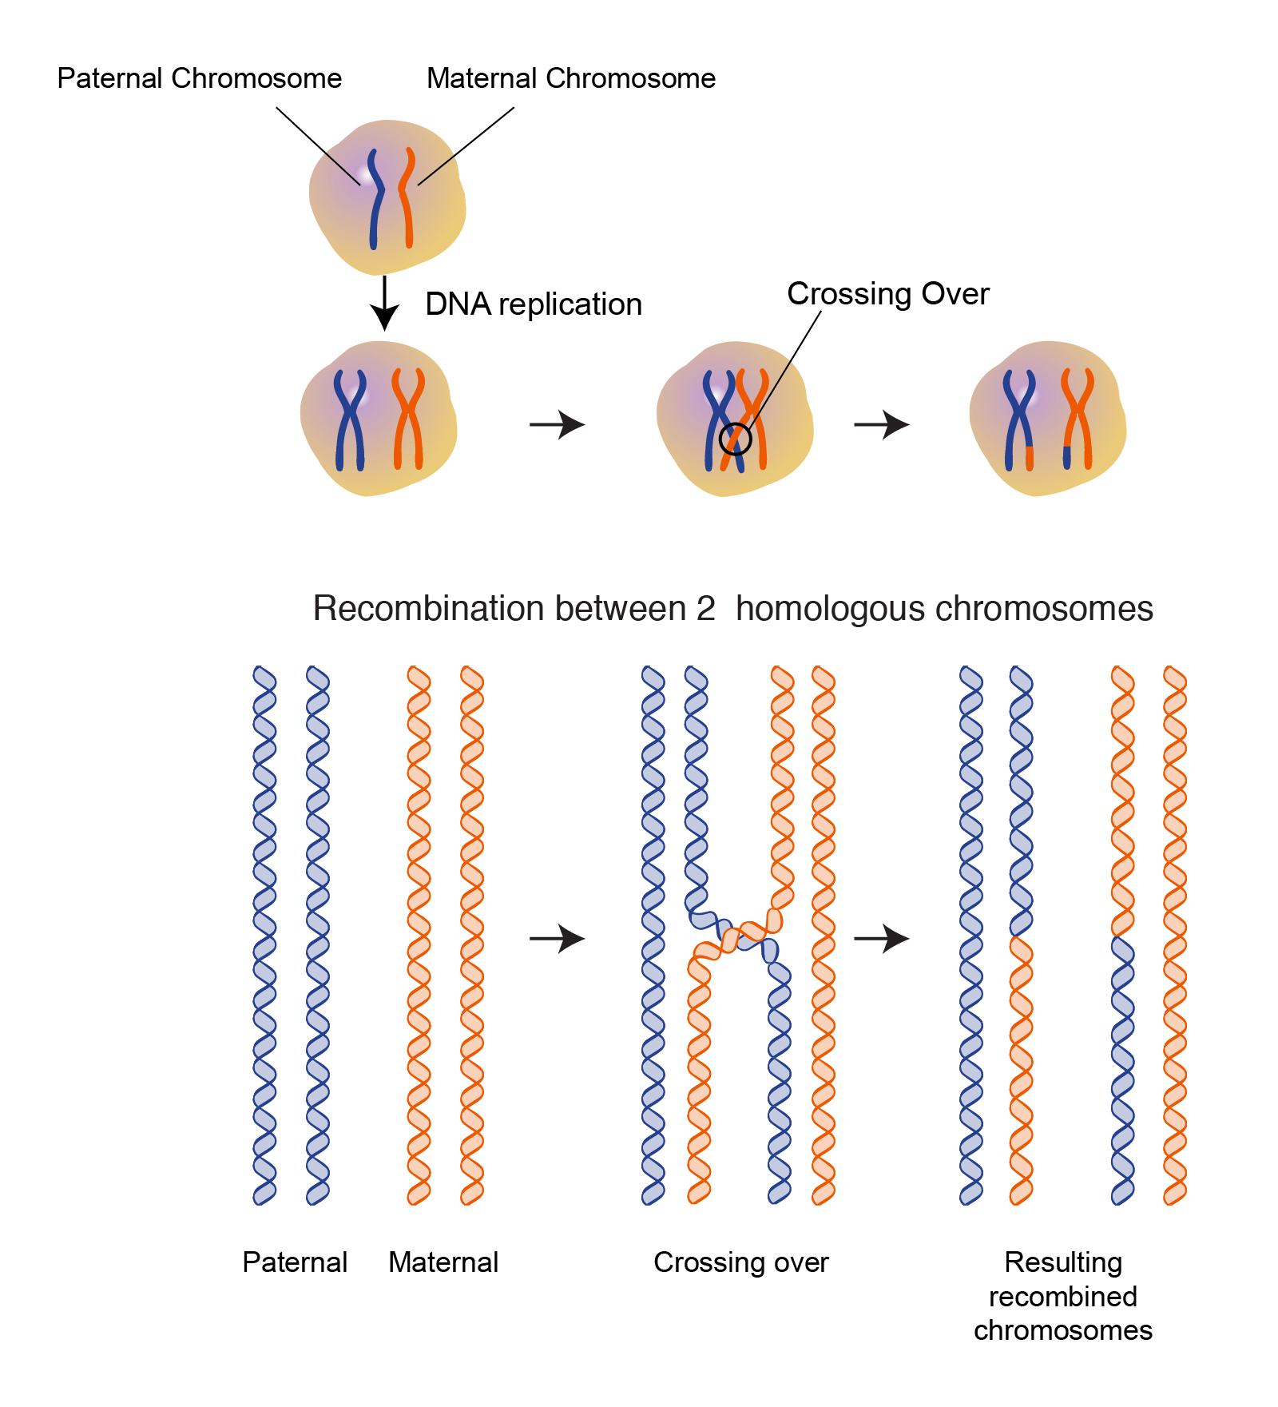
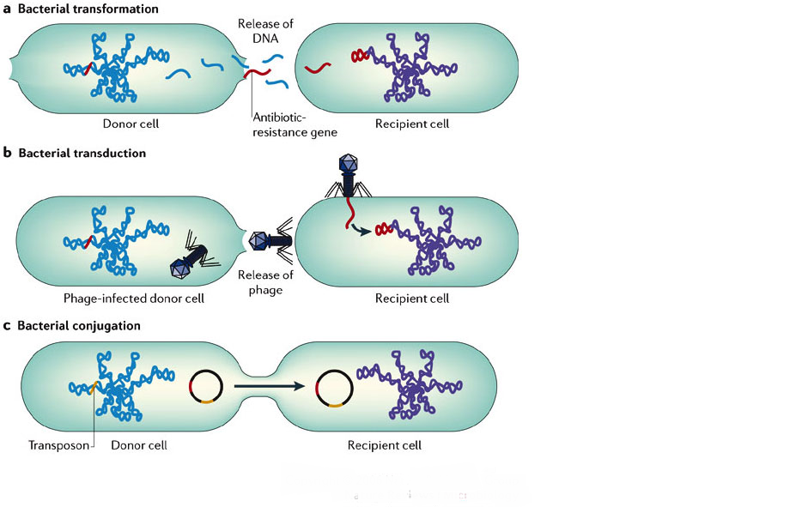
Genetic variation
Mutations
Lateral gene transfer
Recombination

Slide 11
Question 2: What is a potential mechanism that causes genetic change (e.g. mutations, recombination)?
PollEv.com/cvogels425

Slide 12
Population dynamics

Slide 13
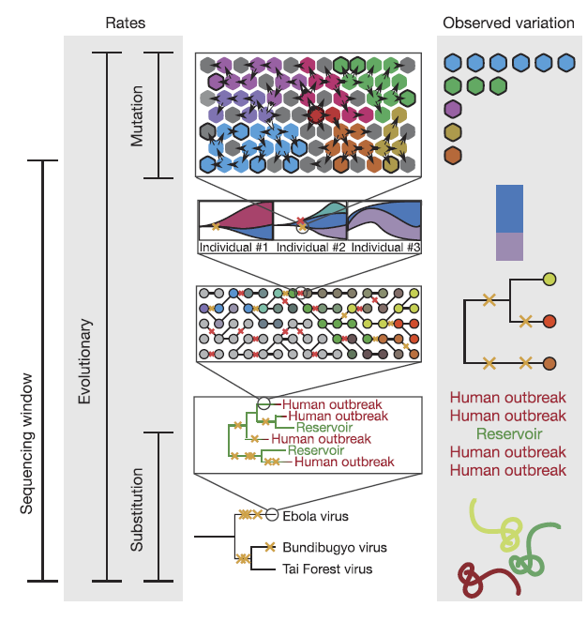
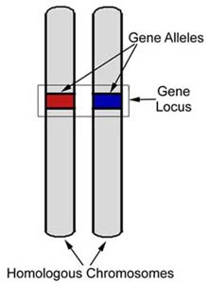
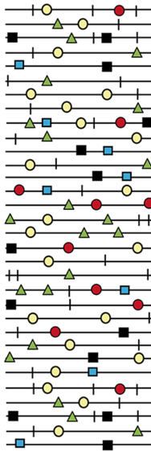
Evolution is a result of changes in allele frequencies in populations
Polymorphism =
multiple variants in population
Diploid organism
Virus
Holmes et al. (2016) Nature

Slide 14
Evolutionary rate is the product of 4 factors
Mutation rate
Generation time
Effective population size (N_{e})
Smallest theoretical population size that can evolve in the same way as the actual population under study
Fitness
Duffy et al. (2016) Nature Reviews

Slide 15
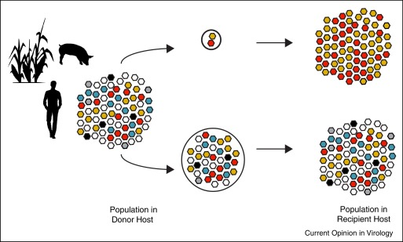
Evolution is never entirely deterministic or stochastic
Deterministic evolution (large populations)
Natural selection = the effect of positive
and negative (purifying) selection pressures
Stochastic evolution (small populations)
Genetic drift = random changes in allele frequencies
Genetic bottlenecks = reduction in population size
Antibiotics
McCrone & Lauring (2018) Current Opinion in Virology

Slide 16
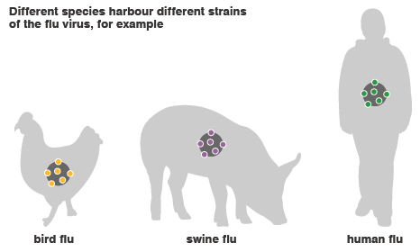
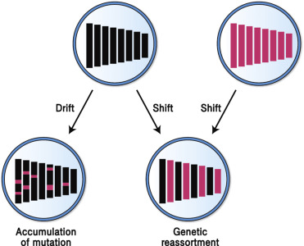
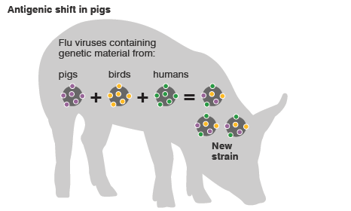
Influenza virus: antigenic drift and shift
Ryu et al. (2017) Molecular Virology of Human Pathogenic Viruses
BBC (2011) Swine flu: how was it created?

Slide 17
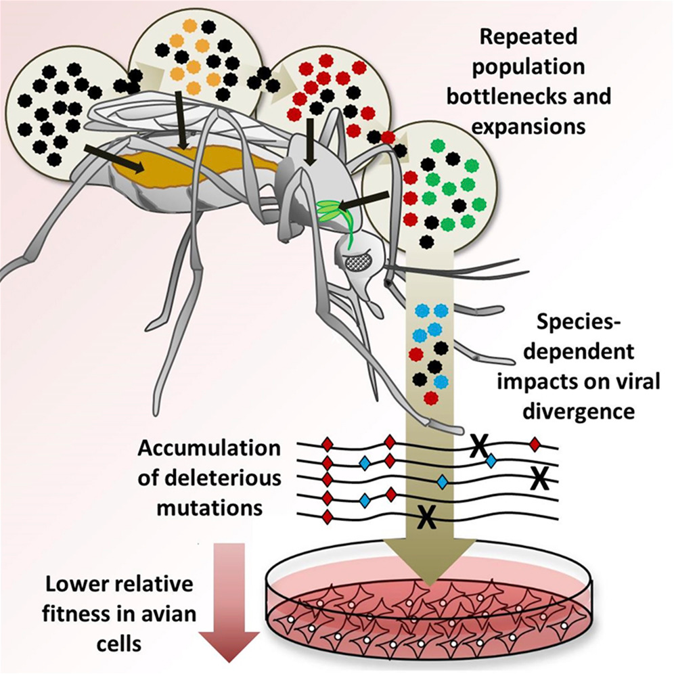
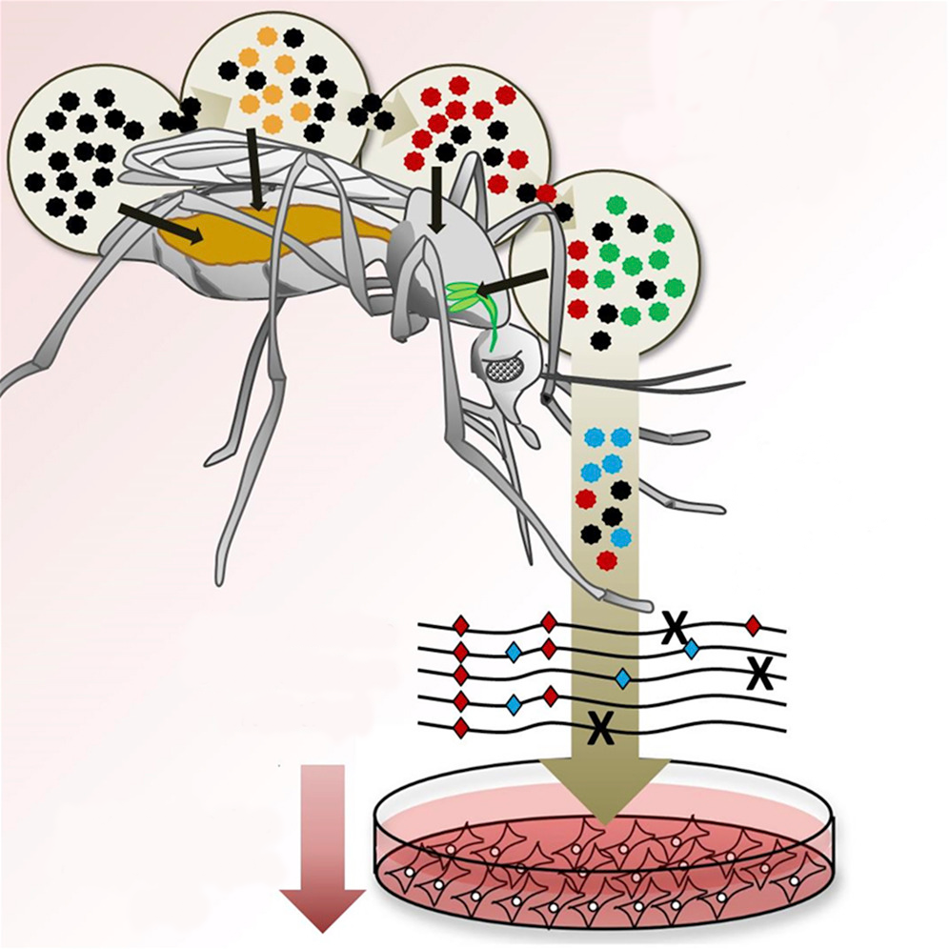
What are the main evolutionary forces on viruses during infection in the mosquito?
Grubaugh et al. (2016) Cell Host & Microbe

Slide 18
Genetics/genomics of viruses

Slide 19
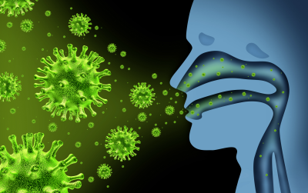
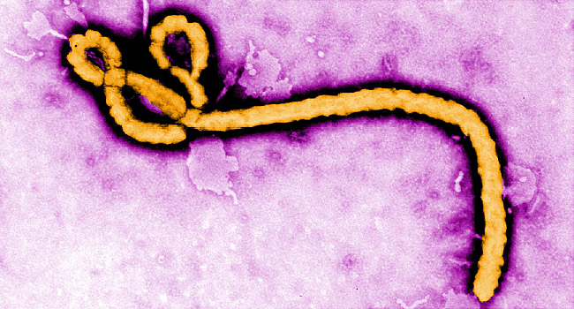
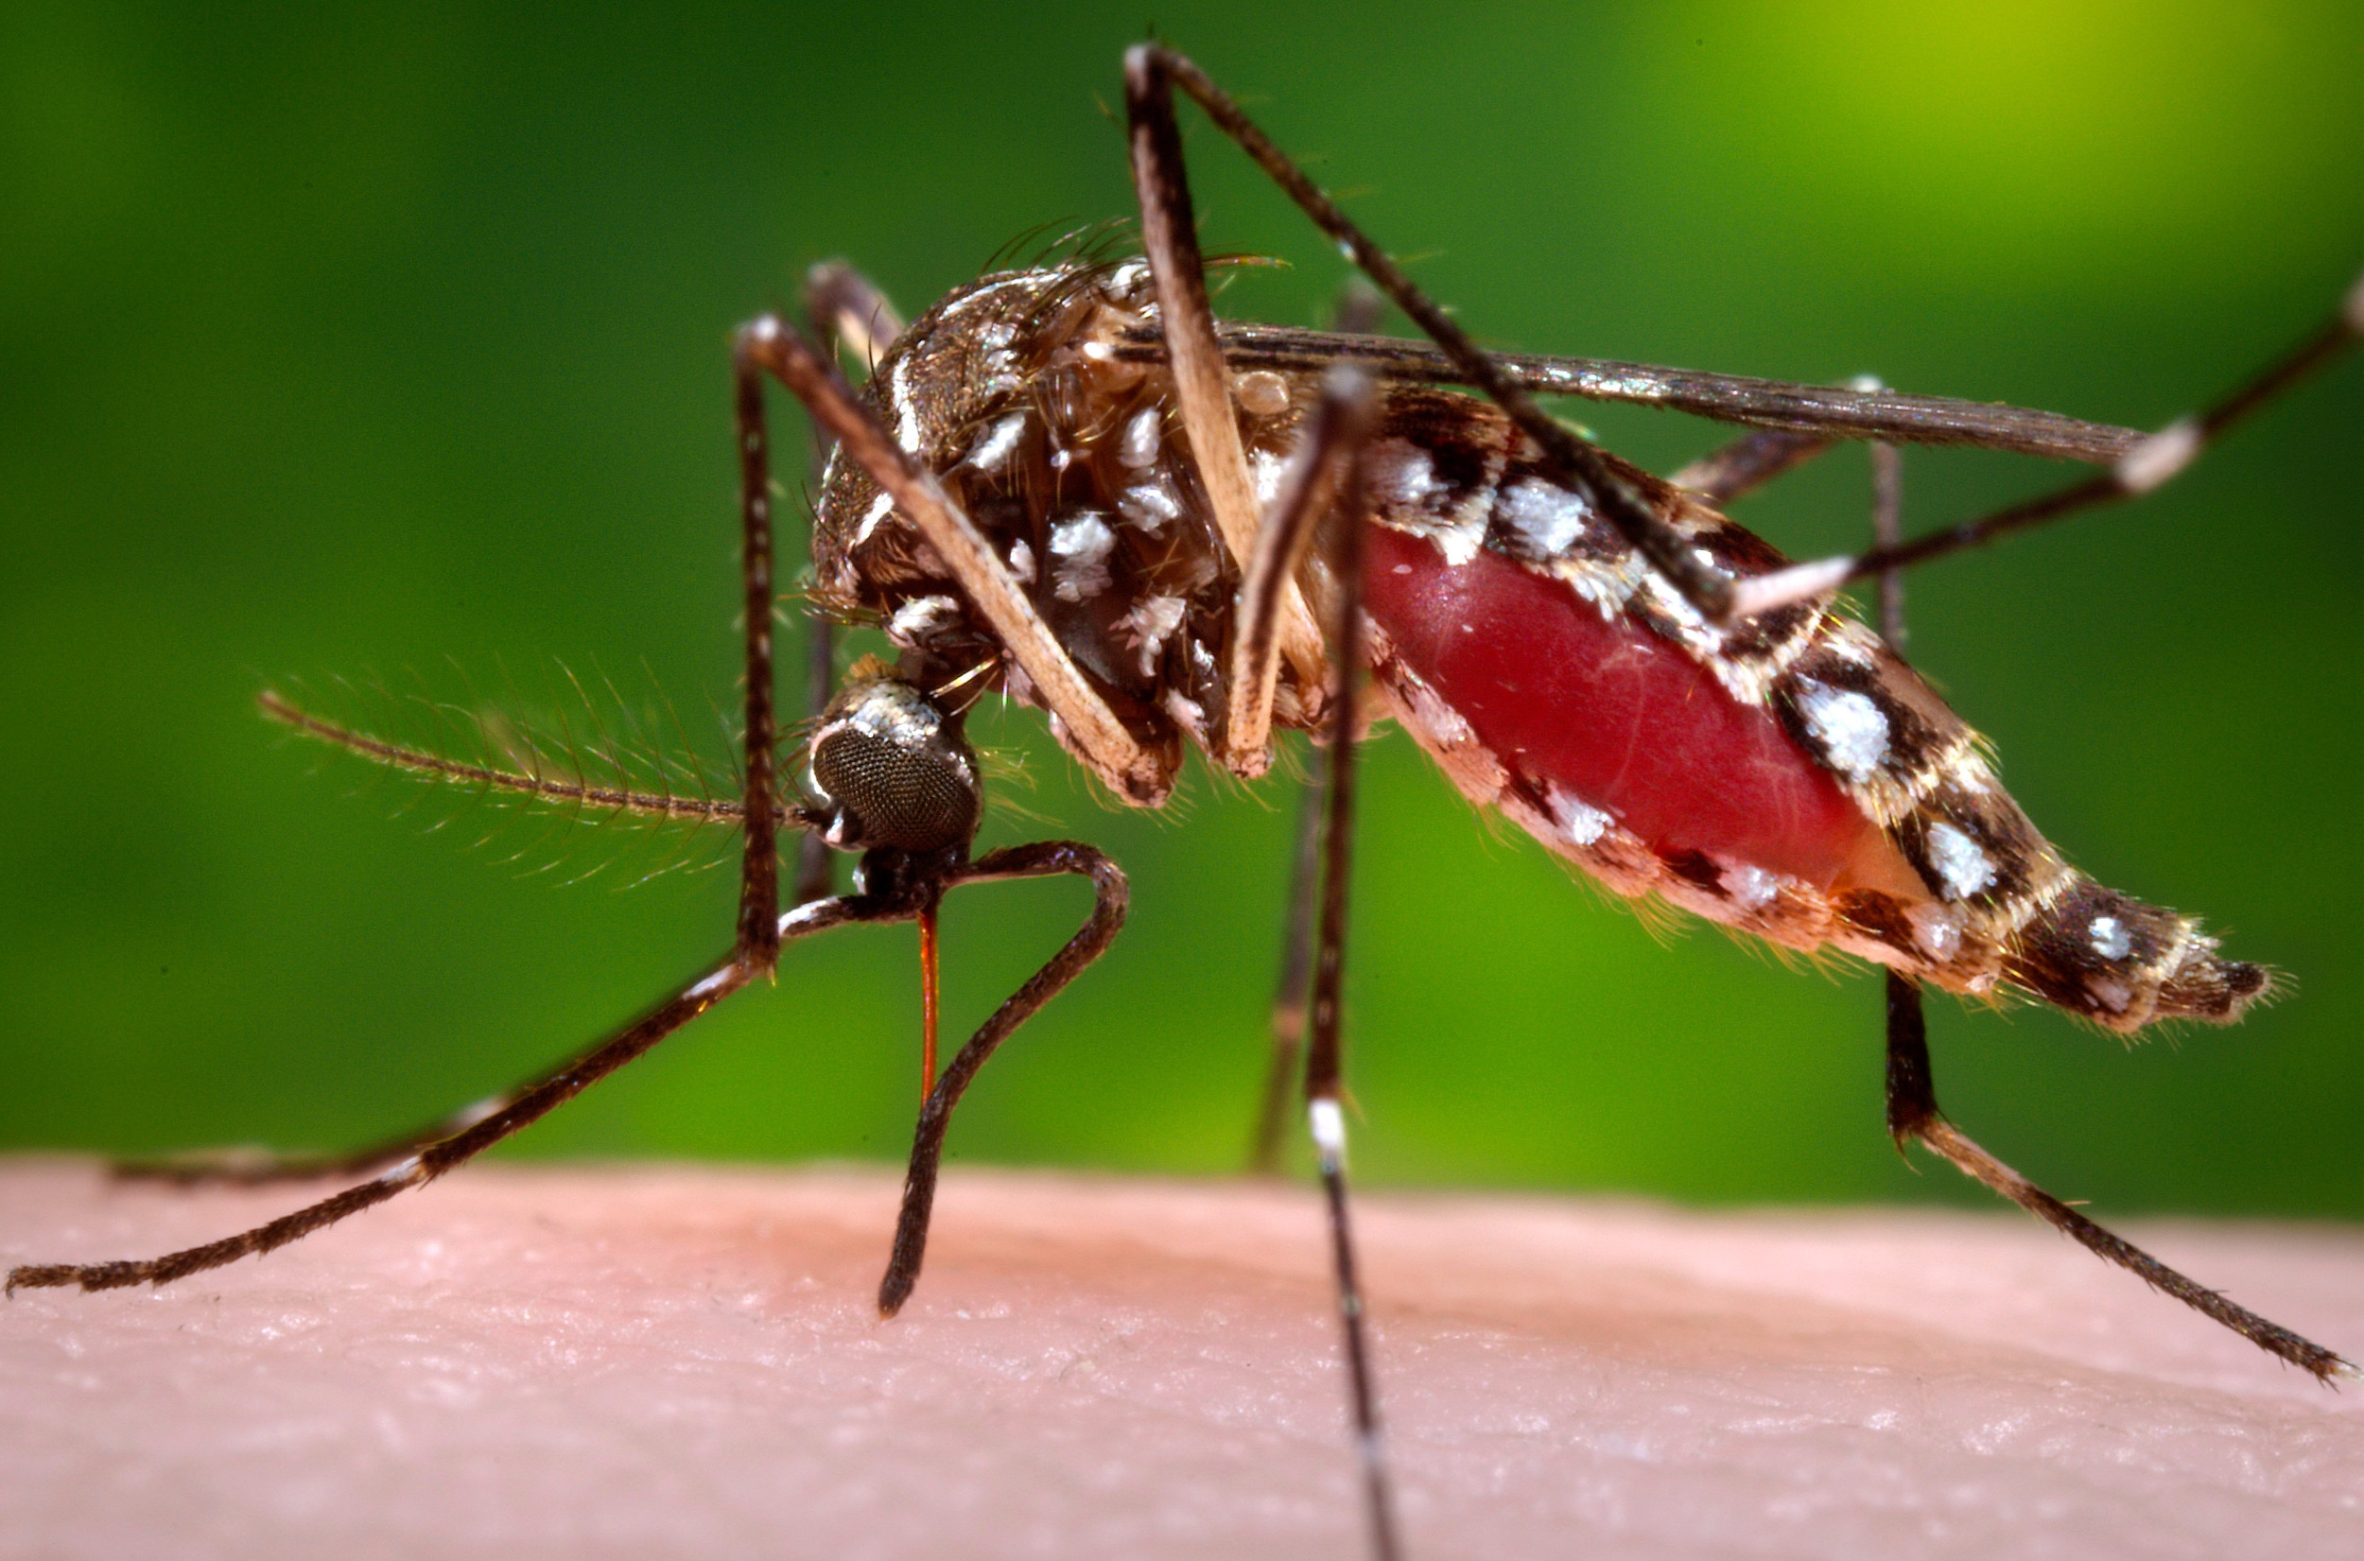
Viral infectious diseases
Influenza
Human Immunodeficiency virus (HIV)
Ebola
Zika
Severe Acute Respiratory Syndrome (SARS)

Slide 20
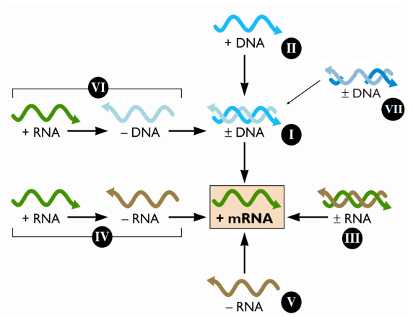
The Baltimore system for virus classification
Parvovirus
Retrovirus
Hepatitis B virus
Adenovirus
Herpes simplex virus
Poliovirus
Zika virus
Reovirus
Rotavirus
Influenza virus
Ebola virus

Slide 21
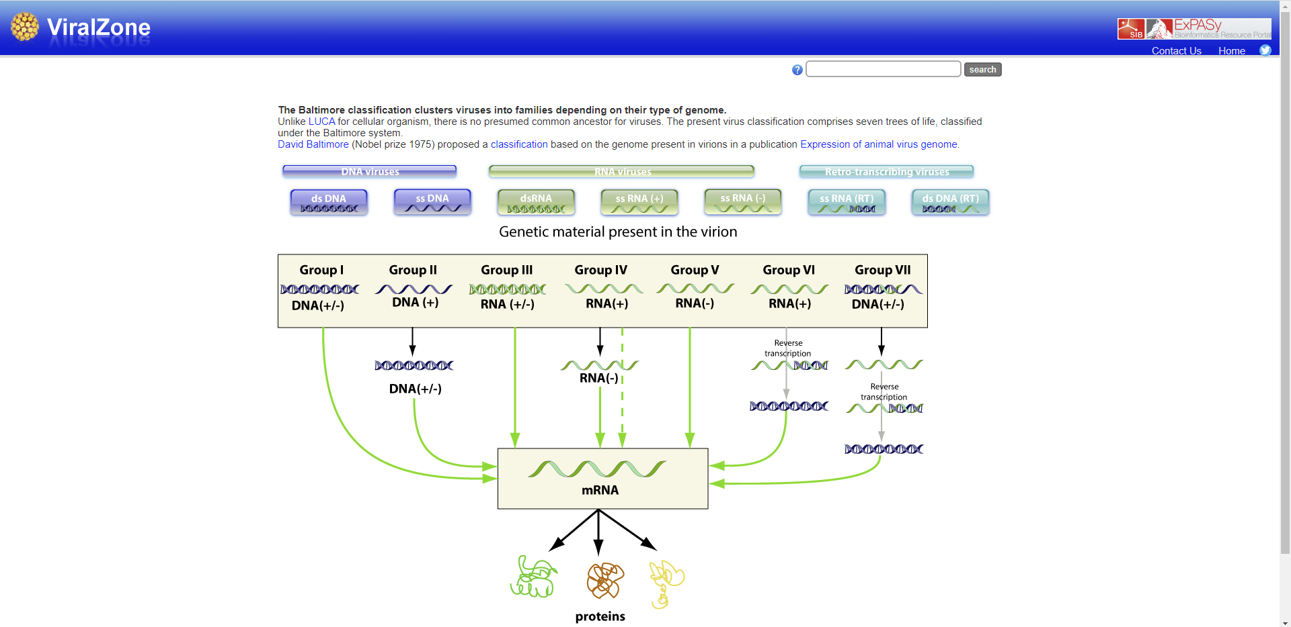
Virus genome structure
https://viralzone.expasy.org/

Slide 22
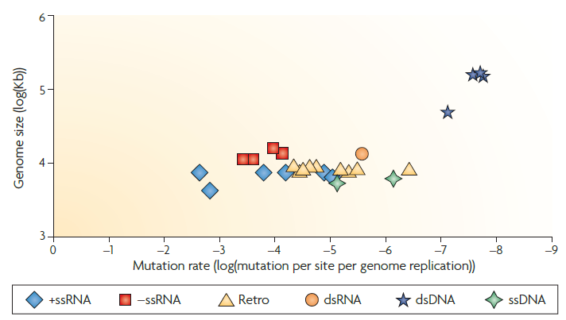
What can explain differences in mutation rates between RNA and DNA viruses?
Duffy et al. (2016) Nature Reviews

Slide 23
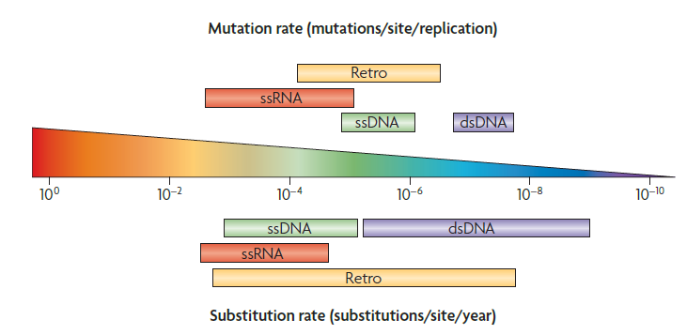
Virus mutation versus substitution rates
Duffy et al. (2016) Nature Reviews

Slide 24
Question 3: What is the difference in evolutionary rate between single host and dual-host viruses?
PollEv.com/cvogels425

Slide 25
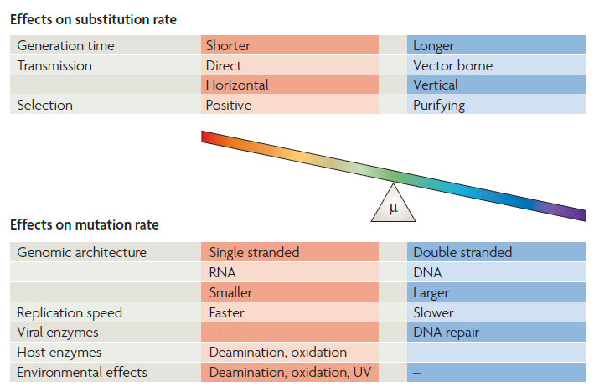
Factors influencing mutation and evolutionary rates in viruses
Duffy et al. (2016) Nature Reviews

Slide 26
Genetics/genomics of bacteria

Slide 27
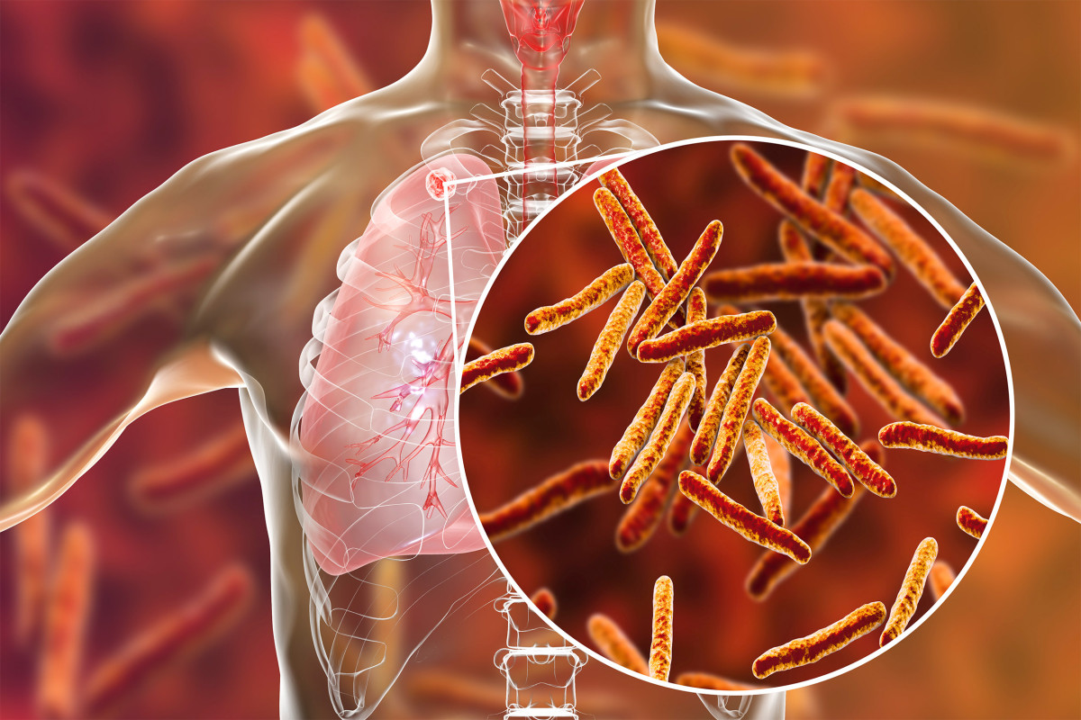
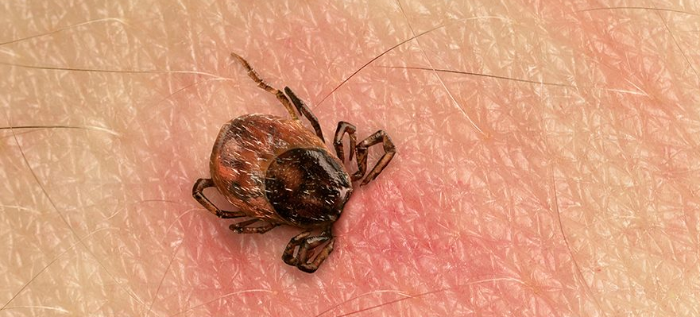
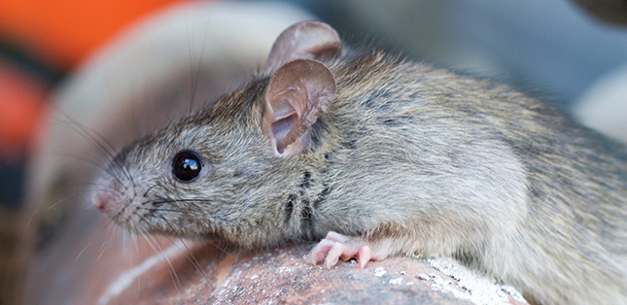
Bacterial infectious diseases
Tuberculosis
Lyme
Plague
Leptospirosis
Salmonella
E. coli

Slide 28
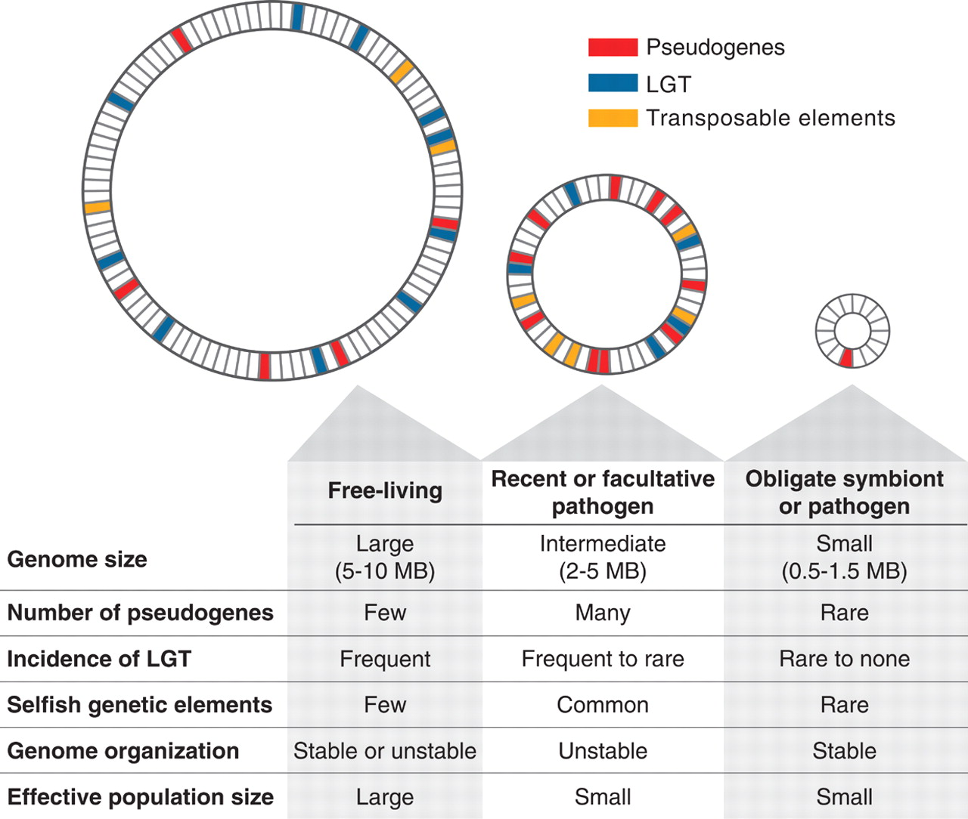
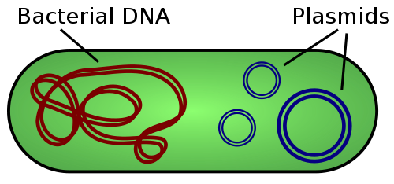
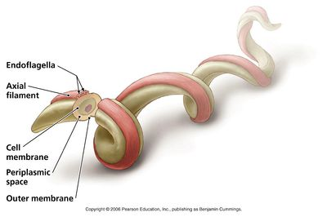
Bacterial genome structure
Prokaryote
Haploid
Circular genome
Plasmids
Ochman & Davalos et al. (2006) Science

Slide 29
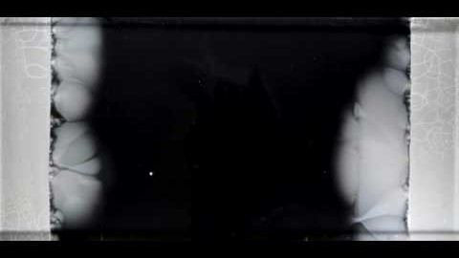
Antibiotic resistance
https://www.youtube.com/watch?v=plVk4NVIUh8&t=1s

Slide 30
Question 4: How do bacteria become resistant?
PollEv.com/cvogels425

Slide 31
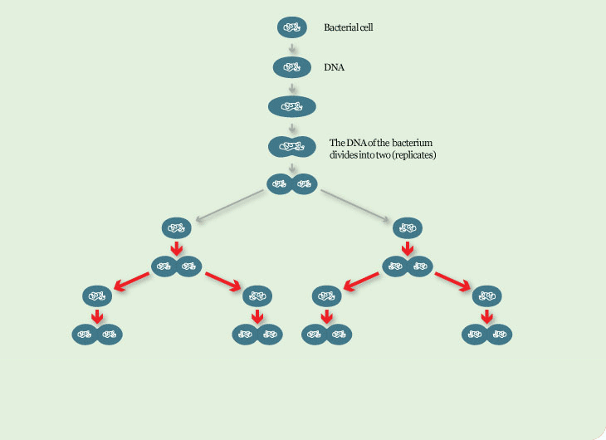
Binary fission and lateral gene transfer

Slide 32
Genetics/genomics of protozoa

Slide 33
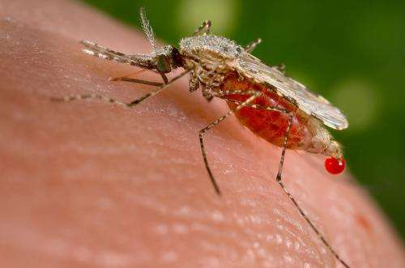
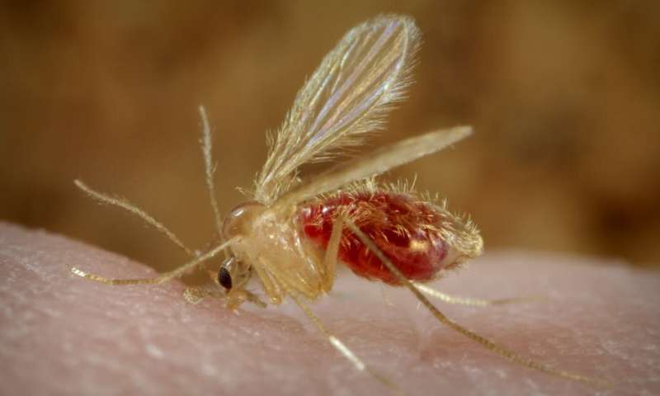
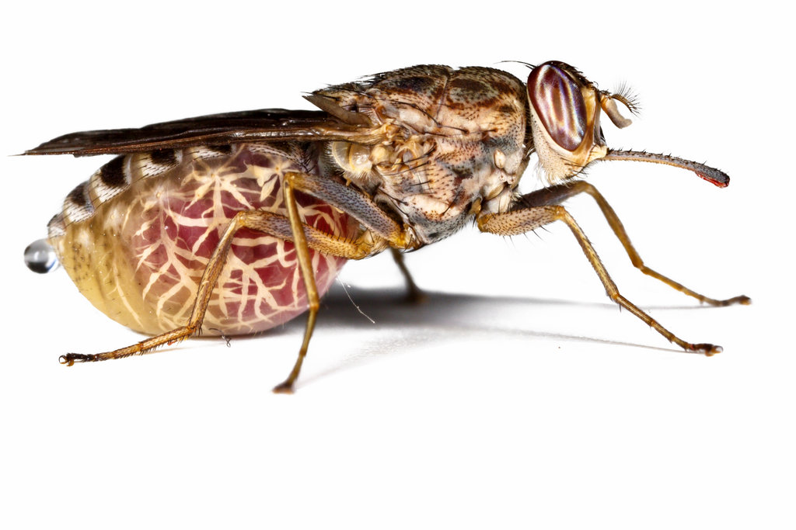
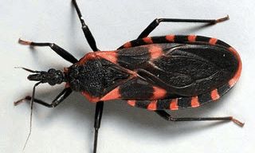
Protozoan infectious diseases
Malaria
Leishmania
Sleeping sickness (Trypanosomiasis)
Chagas
Toxoplasmosis

Slide 34
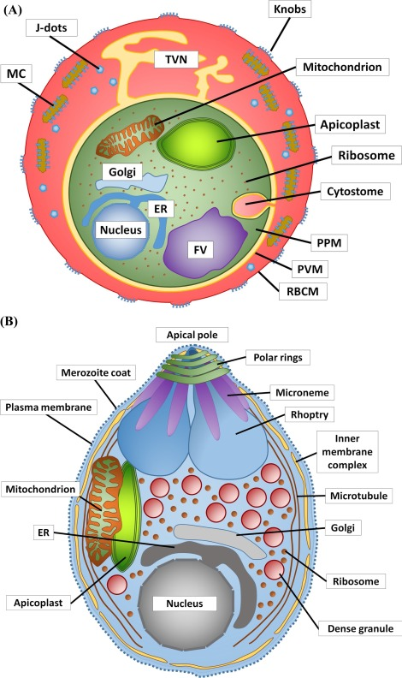
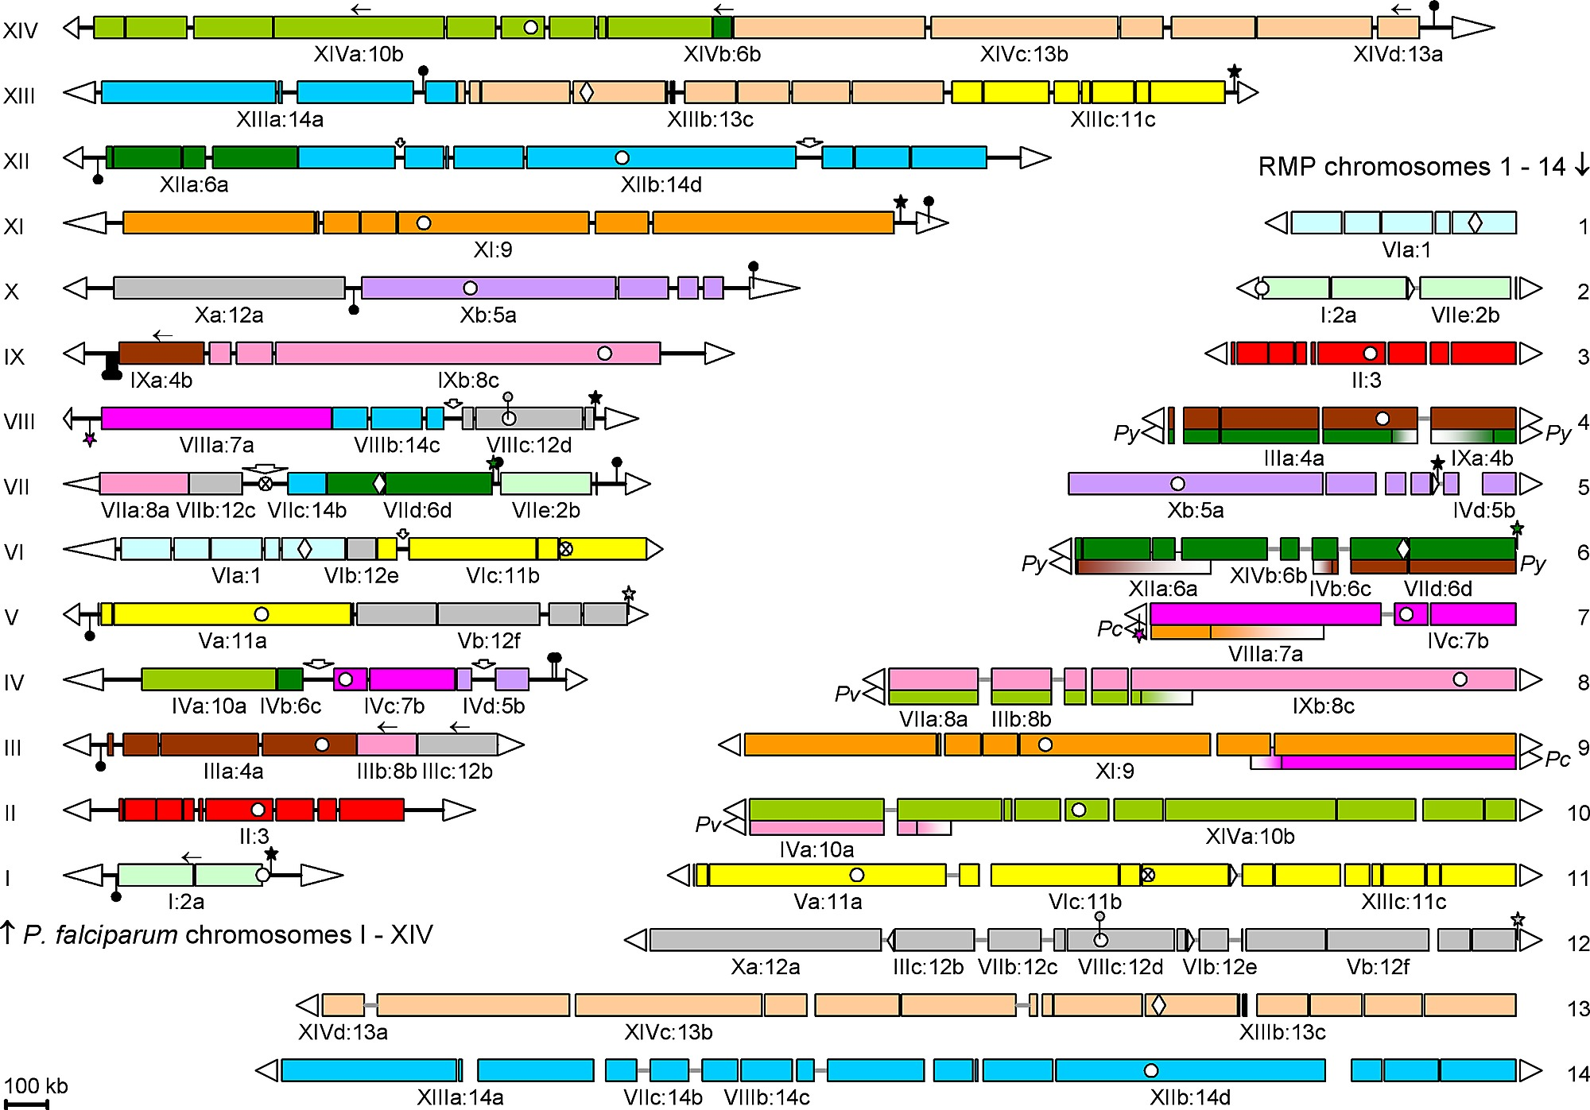
Protozoan genome structure
Eukaryotes
Complex life cycles
Haploid and/or diploid stages
Plasmodium: 20-35Mb, 14 chromosomes, 5268 genes
Kooij et al. (2005) PLOS Pathogens
Flammersfeld et al. (2018) International Journal of Medical Microbiology

Slide 35
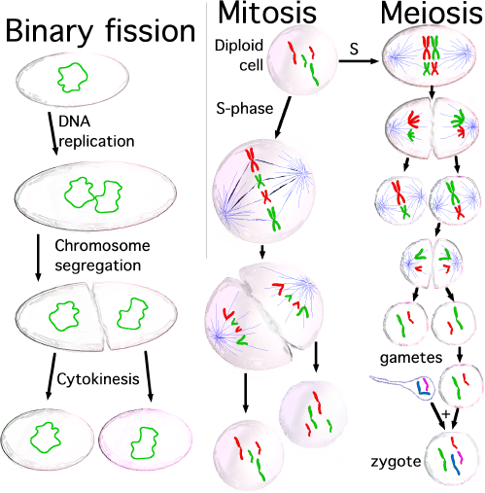
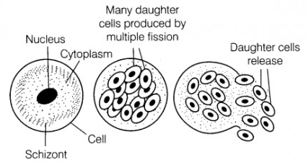
Asexual versus sexual reproduction
Multiple fission

Slide 36
Question 5: Point out a haploid stage in the Plasmodium life cycle
PollEv.com/cvogels425

Slide 37
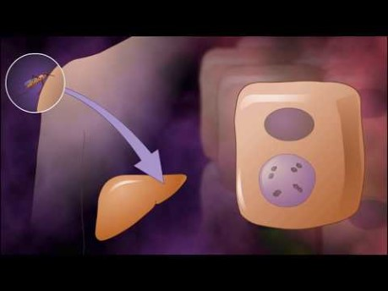
Plasmodium life cycle
https://www.youtube.com/watch?v=qMz8B0nVZ4M

Slide 38
How can we translate pathogen evolution into epidemiology?

Slide 39
RNA virus evolution

Slide 40
RNA virus evolution
Fast replication

Slide 41
RNA virus evolution
High mutation

Slide 42
RNA virus evolution
Large populations

Slide 43
RNA virus evolution
Transmission bottlenecks

Slide 44
RNA virus evolution

Slide 45
RNA virus evolution

Slide 46
RNA virus evolution

Slide 47
RNA virus evolution

Slide 48
RNA virus evolution

Slide 49
RNA virus evolution
Evolution on an epidemiological timescale

Slide 50
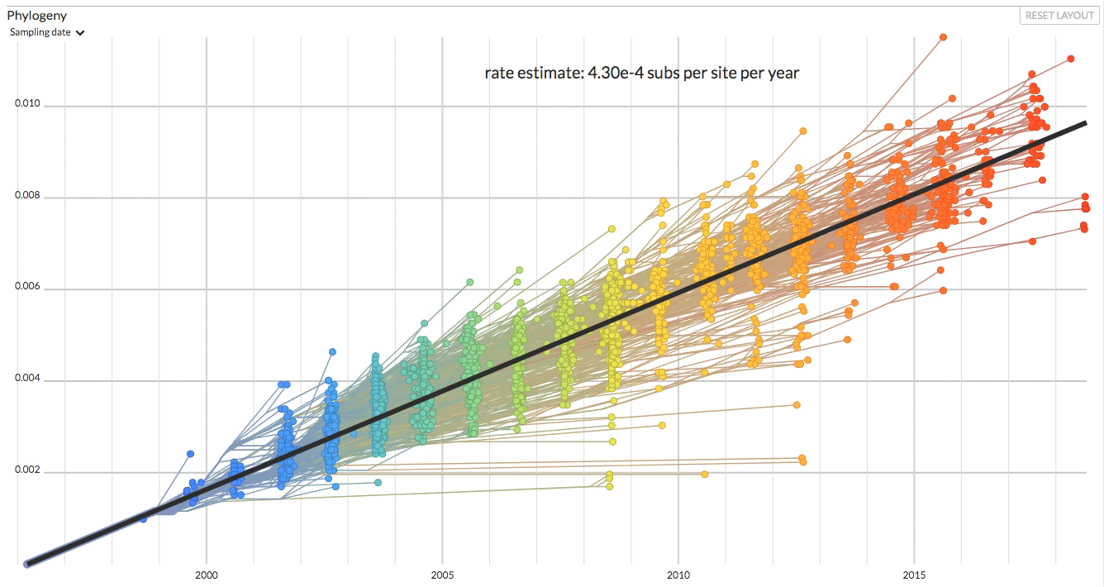
‘Molecular clock’ to phylogenetic tree

Slide 51
‘Molecular clock’ to phylogenetic tree

Slide 52
